Slide 1
Tries

Slide 2
Preprocessing Strings
Preprocessing the pattern speeds up pattern matching queries
After preprocessing the pattern, KMP’s algorithm performs pattern matching in time proportional to the text size
If the text is large, immutable and searched for often we may want to preprocess the text instead of the pattern
A trie is a compact data structure for representing a set of strings, such as all the words in a text
A tries supports pattern matching queries in time proportional to the pattern size

Slide 3
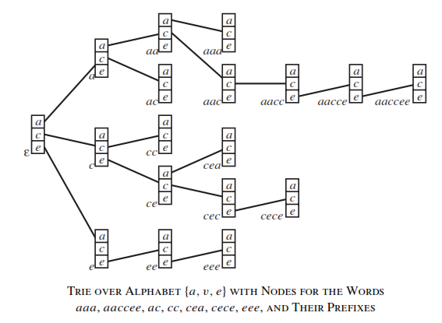
Standard Tries

Slide 4
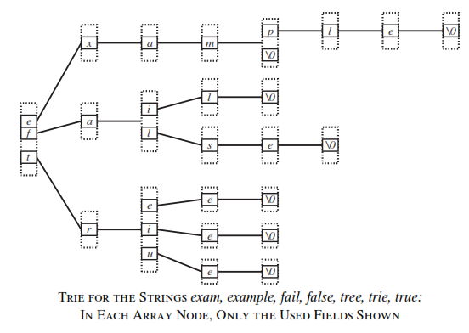

Slide 5
Operations on Tries
A – Alphabet set
|A| - No. of alphabets in A
Find – O(length(s))
Insert – O(|A|*length(s))
Delete – O(|A|*length(s))
Space Complexity : To store n strings w₁, w₂, .. w_{n} is O(|A|*∑ _{i} length(w_{i}))

Slide 6
Insert(t, P[k..m])
if t is not leaf then //otherwise P is already present
if t.child(P[k])=nil then
Create a new child of t and a “branch”
starting with that child and storing P[k..m]
else Trie-Insert(t.child(P[k]), P[k+1..m])
Search(t, P[k..m])
if t is leaf then return true
else if t.child(P[k])=nil then return false
else return Search(t.child(P[k]), P[k+1..m])

Slide 7
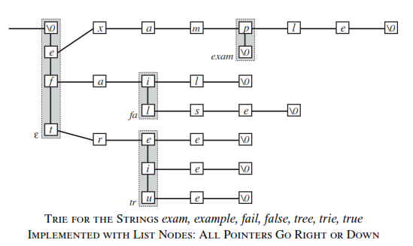

Slide 8
Compressed Tries
A compressed trie has internal nodes of degree at least two
It is obtained from standard trie by compressing chains of “redundant” nodes

Slide 9
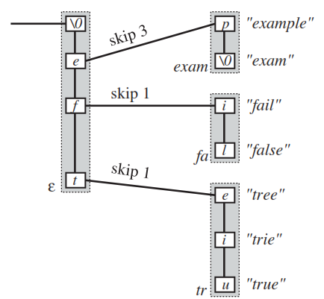
Patricia Tree

Slide 10
Operations on Patricia Tree
A – Alphabet set
|A| - No. of alphabets in A
No. of words stored - n
Find (s) – O(length(s))
Insert(s) – O(|A|*length(s))
Delete(s) – O(|A|*length(s))
Space Complexity : To store n strings w₁, w₂, .. w_{n} is O(n|A|*∑ _{i} length(w_{i}))

Slide 11
Word prefix query: find all words in T, which start with P[0..m-1]
Patricia-Search(t, P, k)
if t is leaf then
j ← the first index in the t.list
if T[j..j+m-1] = P[0..m-1] then
return t.list // exact match
else if there is a child-edge (P[k],s) then
if k + s < m then
return Patricia-Search(t.child(P[k]), P, k+s)
else go to any descendent leaf of t and do the check of line 03, if it is true, return lists of all descendent leafs of t, otherwise return nil
else return nil

Slide 12

Dictionaries Allowing Errors in Queries
A dictionary structure that keeps track of a set of strings and ﬁnds all strings that differ only in d characters from the query string
Suppose we have a set of n words w₁, w₂, … w_{n} over an alphabet A, with total length
and we want to preprocess this into a structure that can ﬁnd all words of our set that differ in at most d places from a query string q for some ﬁxed d.

Slide 13
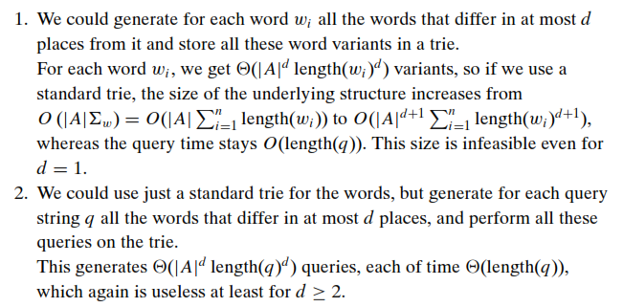

Slide 14
Query with error in at most 1 character position
Use two trie structures
One for all the given words
One for reverse of all the given words
Each node in the ﬁrst trie corresponds to some preﬁx p of some word w, and each node in the second trie corresponds to some sufﬁx s of a word w.

Slide 15
For each word w, look at all pairs of (preﬁx, sufﬁx) that are separated by a single character, w = pcs, where c is a character.
Each word w_{i} generates length(w_{i}) for such pairs (p, s), which are represented by pairs of trie nodes.
Generate all these pairs for a given word:
Follow in the ﬁrst trie the path of the word to its end, pushing a pointer for each passed node on the stack,
Follow in the second trie the path of the reversed word, pairing each node we reach in the second trie with the corresponding next node from the stack.

Slide 16
Time required to generate all the node pairs is O(length(w_{i})).
Each of these pairs are entered in search-tree, together with a pointer to the word w_{i} that generated that pair.
The total number of pairs are ∑_{w}, so each search-tree operation costs only O(log ∑_{w}).
Time to build the structure is O(∑_{w} log ∑_{w}).

Slide 17
The query method:
Follow the path of the query word in the ﬁrst trie as far as possible (Maximum prefix), pushing a pointer to each visited node on the stack.
Follow the path of the reversed word in the second trie until one character before the end of that maximum preﬁx.
Continue to follow the path in the second trie, pair each visited node with a preﬁx node from the stack and look up in the search tree whether that node pair belongs to any correct word.
Thus the query time is O(length(q)log ∑_{w})

Slide 18
Suffix Tree
The suffix trie of a string X is the compressed trie of all the suffixes of X

Slide 19
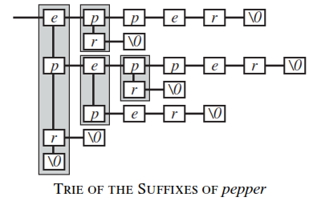

Slide 20
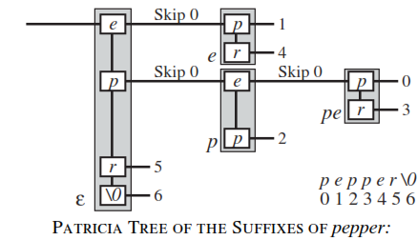

Slide 21
Ukkonen’s Algorithm
To construct the sufﬁx tree of a given string s = c₀ ...c_{n-1}:
Create the root node, representing the trie of the empty string.
Set the active node to that node, and i = 0.
While i<n
While the active node has no entry for c_{i}
Create a new node, reached from the active node by the entry for c_{i}. This new node is a leaf.
Move the active node down its sufﬁx link if it is not already the root.
Move the active node up the link for c_{i} unless it is the root and we just created that link. Increment i.

Slide 22
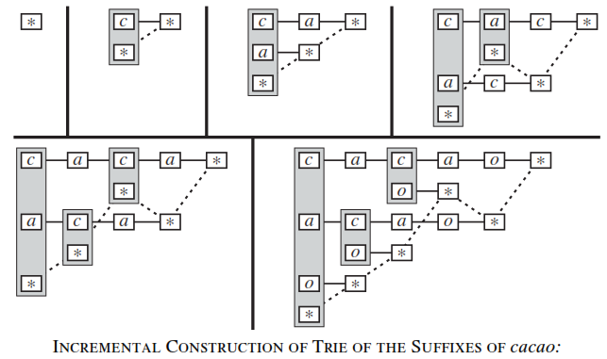
Ukkonen’s method for Suffix Tree Construction

Slide 23
Time required to build suffix tree for string s is O(length(s))
Memory required to store suffix tree is O(n)
Time for processing substring queries O(length(q)).

Slide 24
Suffix Arrays
All sufﬁxes of the string s is stored in lexicographic order
To ﬁnd a given query string, binary search is performed on them
0 | 1 | aximum
1 | 3 | imum
2 | 6 | m
3 | 0 | maximum
4 | 4 | mum
5 | 5 | um
6 | 2 | ximum

Slide 25
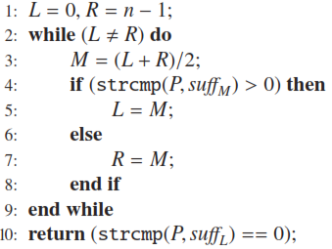
Algorithm SEARCH(P, Suff_{0..n-1})

Slide 26
Disadvantage: Query time to ﬁnd a string q in the long string s depends on length(s)
Without additional information, time required is O(length(q) log length(s));
With additional information on the length of common preﬁxes of the sufﬁxes of s, this reduces to O(length(q) + log length(s)).
Requires variable length array for storing strings
The sufﬁx tree needs only O(length(q)) query time, independent of s.

Slide 27
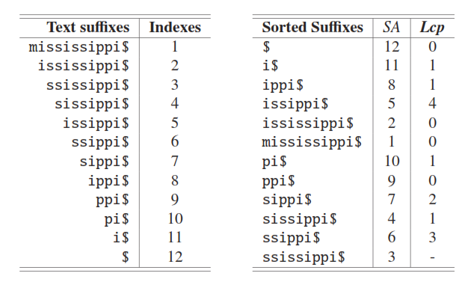
Length of Common Prefix
S = mississippi

Slide 28
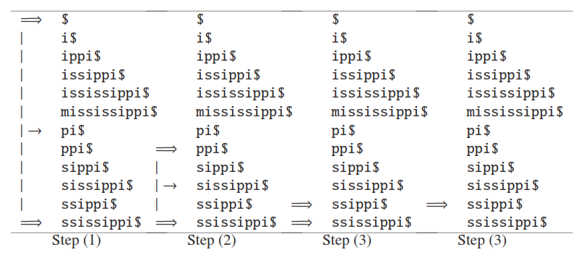
Searching for “ssi” in “mississippi”

Slide 29
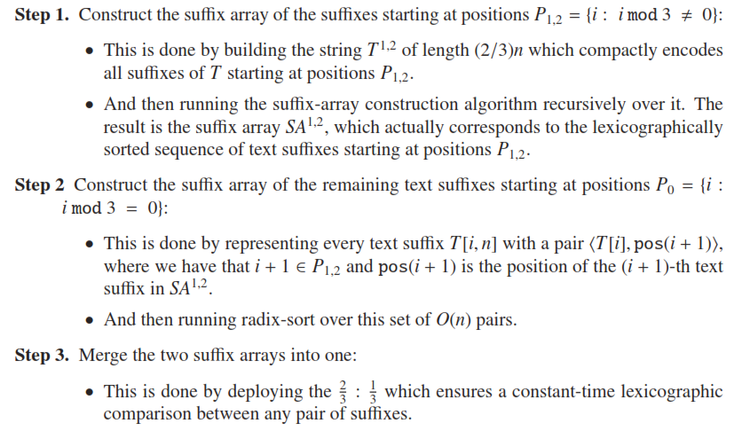
Skew Algorithm for Suffix Array Construction

Slide 30
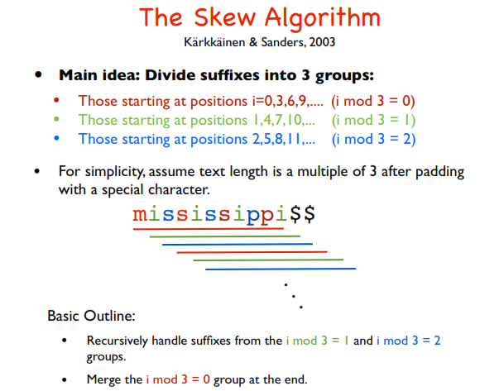

Slide 31
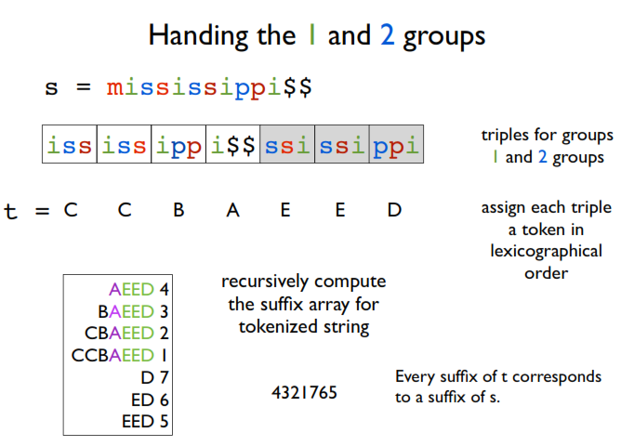

Slide 32
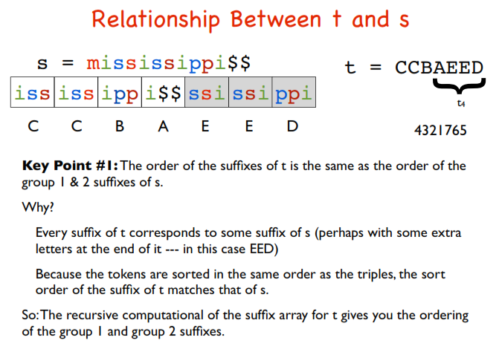

Slide 33
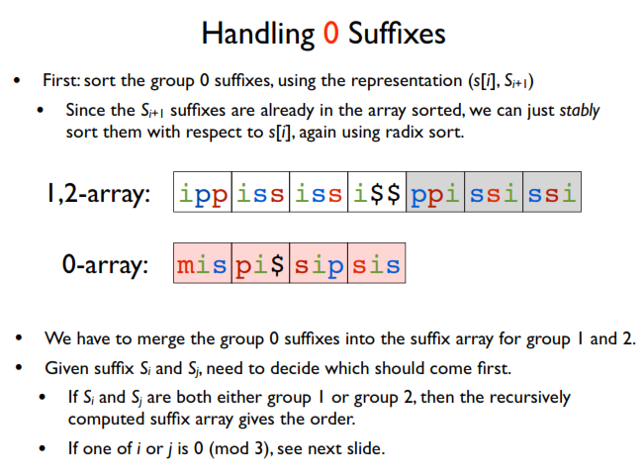

Slide 34
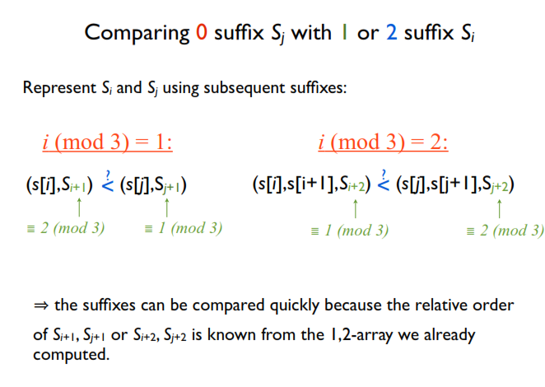

Slide 35
SA^{1,2} Suffixes

Slide 36

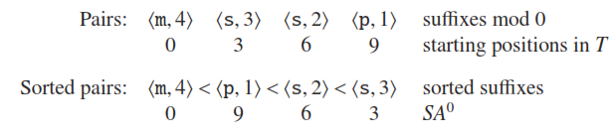
SA⁰ Suffixes

Slide 37
